Slide 1

Capstone Project Lecture Business Intelligence Systems (BIS)
Luisa Sophie Barth
Katrin Iris Krebs
Duy Vu
Timon Kwade
Jan Frieling
Stefan Stumpf

Slide 2

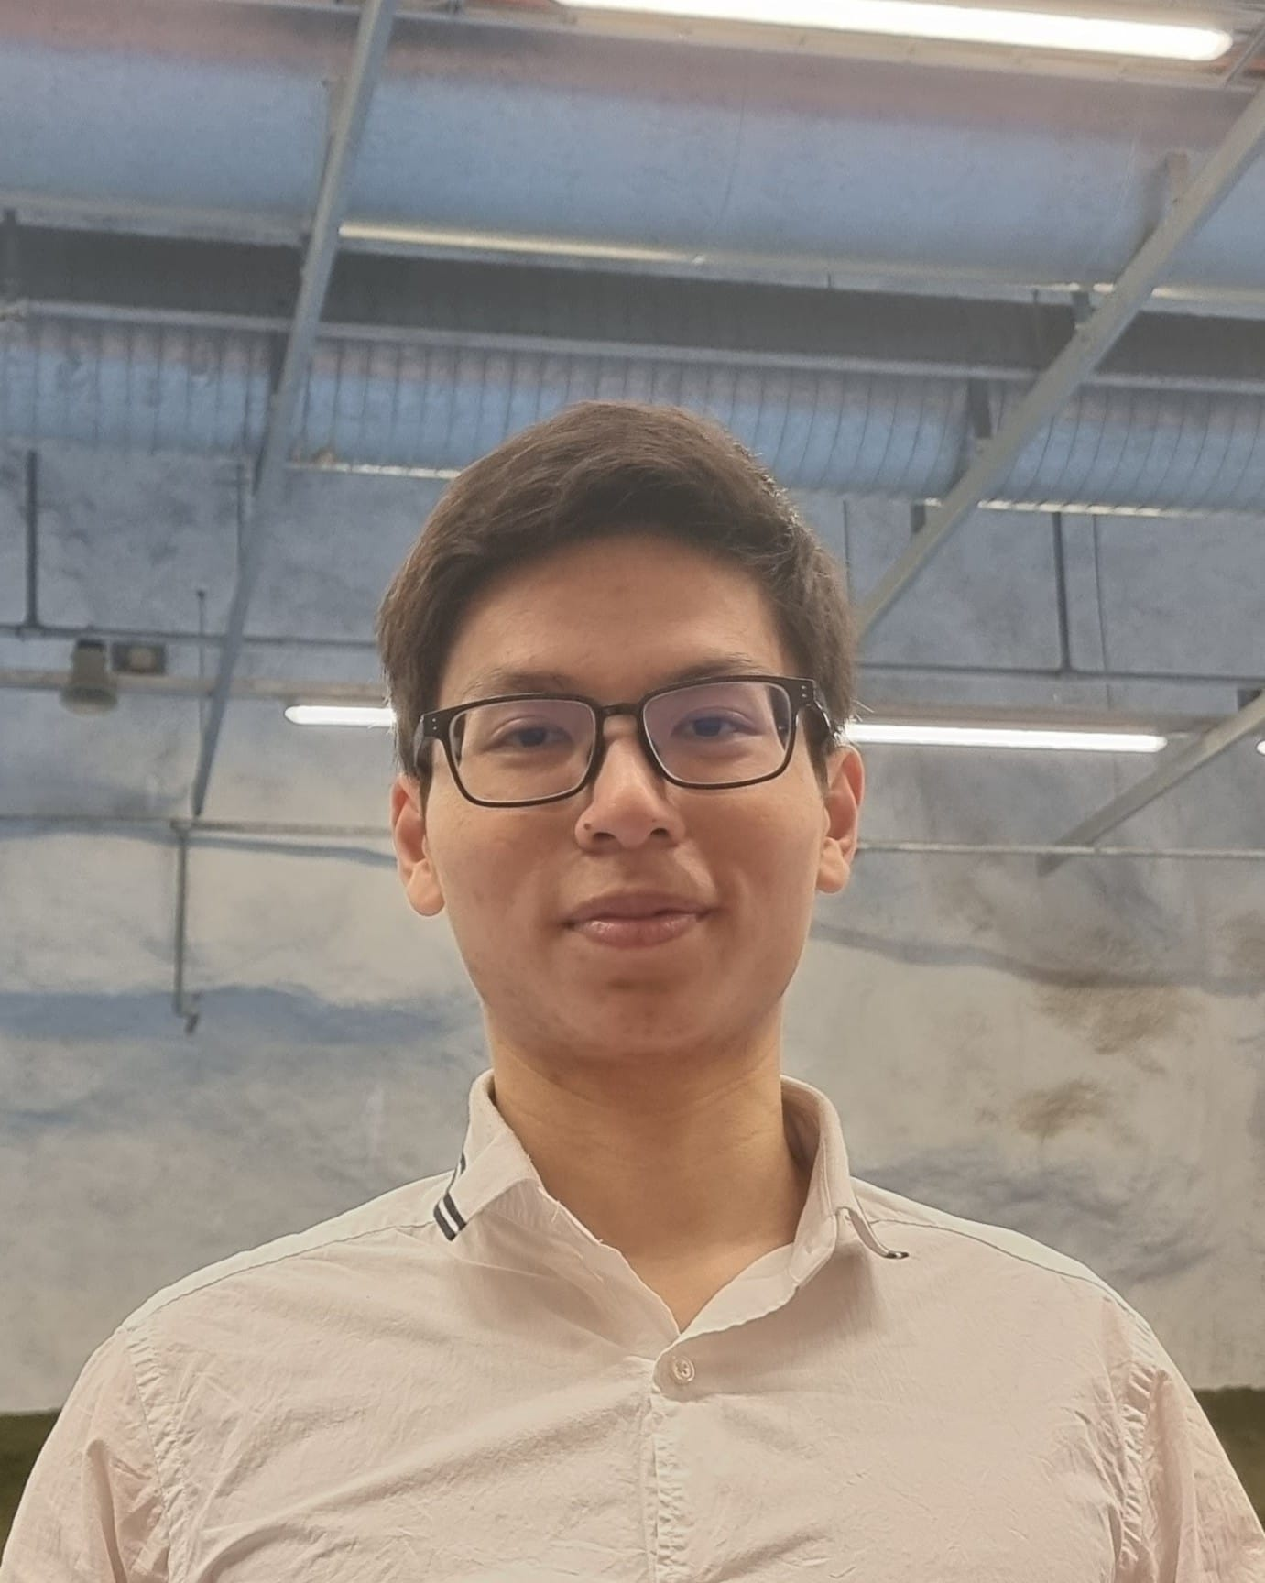
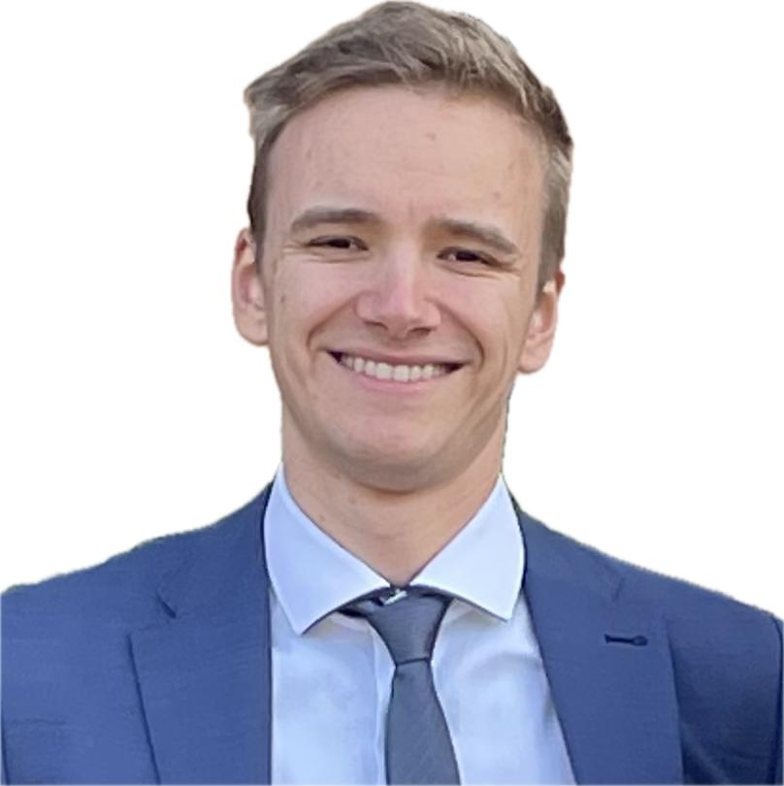


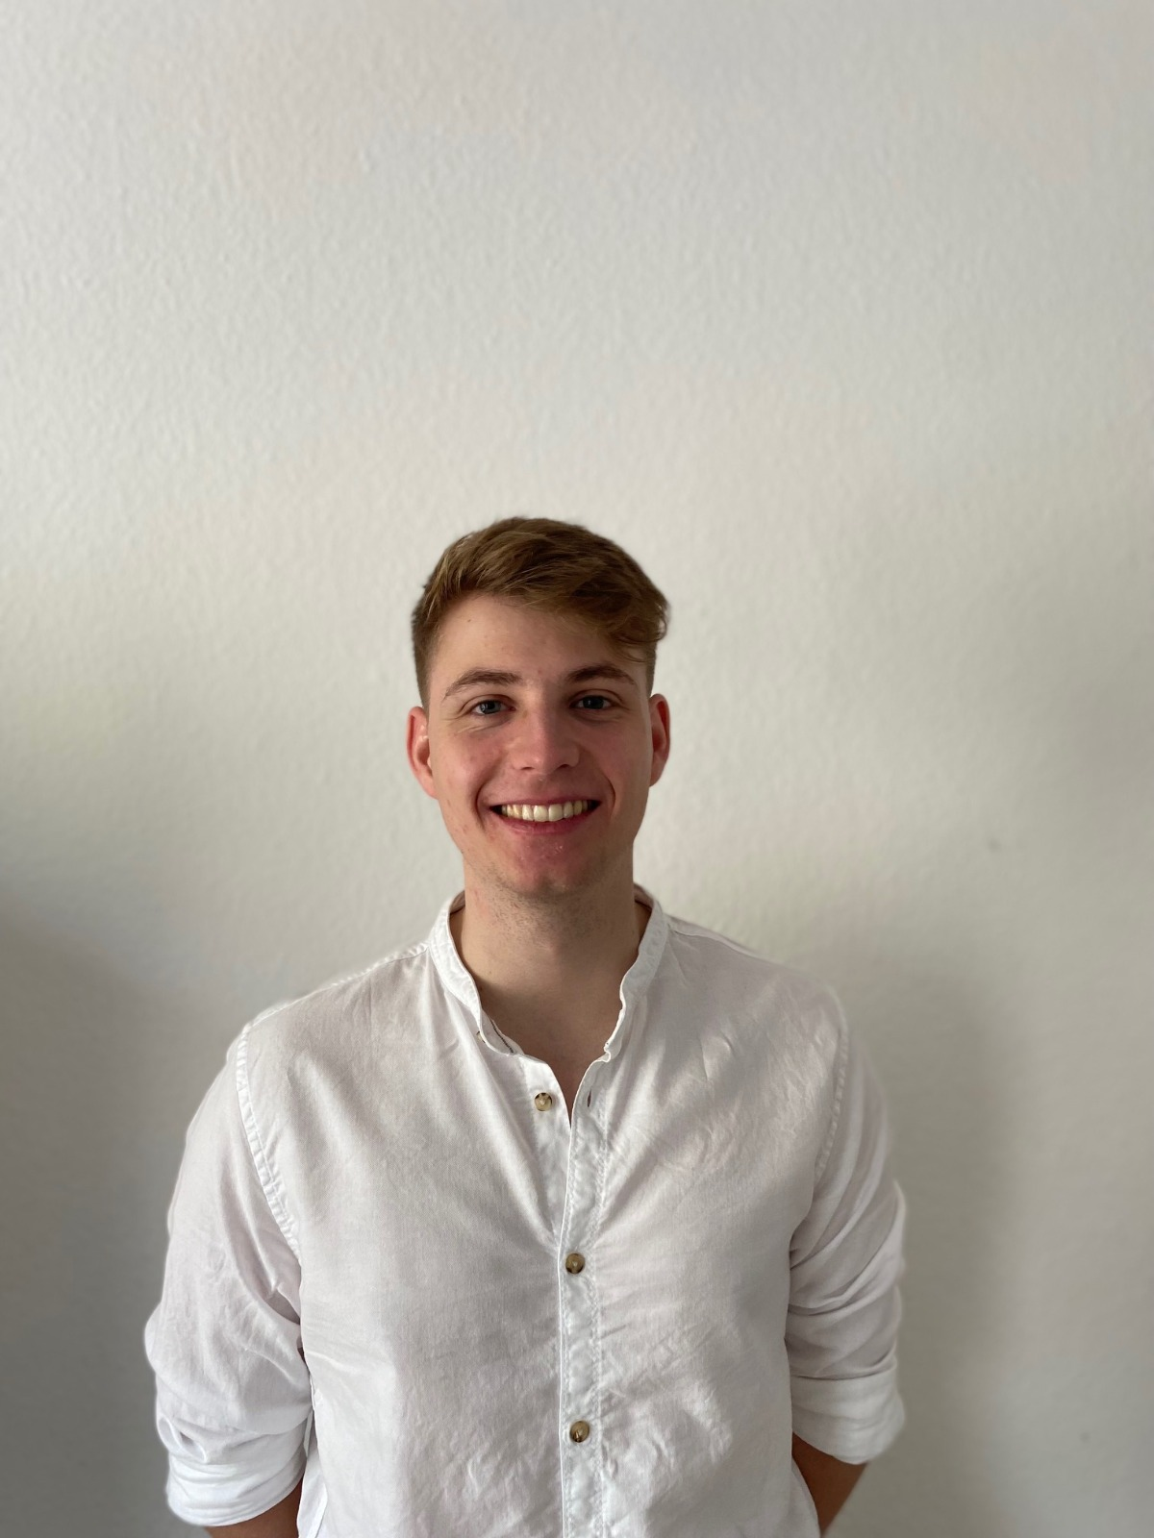
Luisa Barth
Duy Vu
Jan Frieling
Katrin Krebs
Timon Kwade
Stefan Stumpf

Slide 3
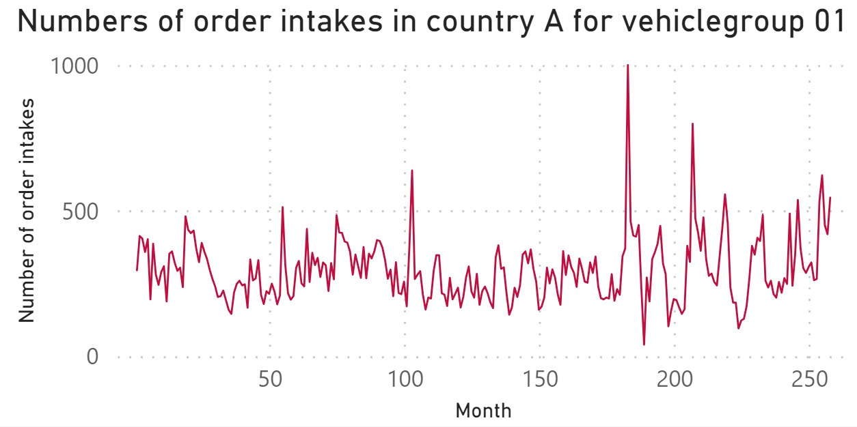
Historical data shows constant demand over last 18.5 years and slight positive trend during the last 3 years
Constant demand until month ~222
Little need to adjust planning (e.g. in purchasing, production & marketing)
Weak upward trend & higher volatility in demand since month ~222
Greater need to adapt planning
Planning adjustment based on future demand estimation

Slide 4
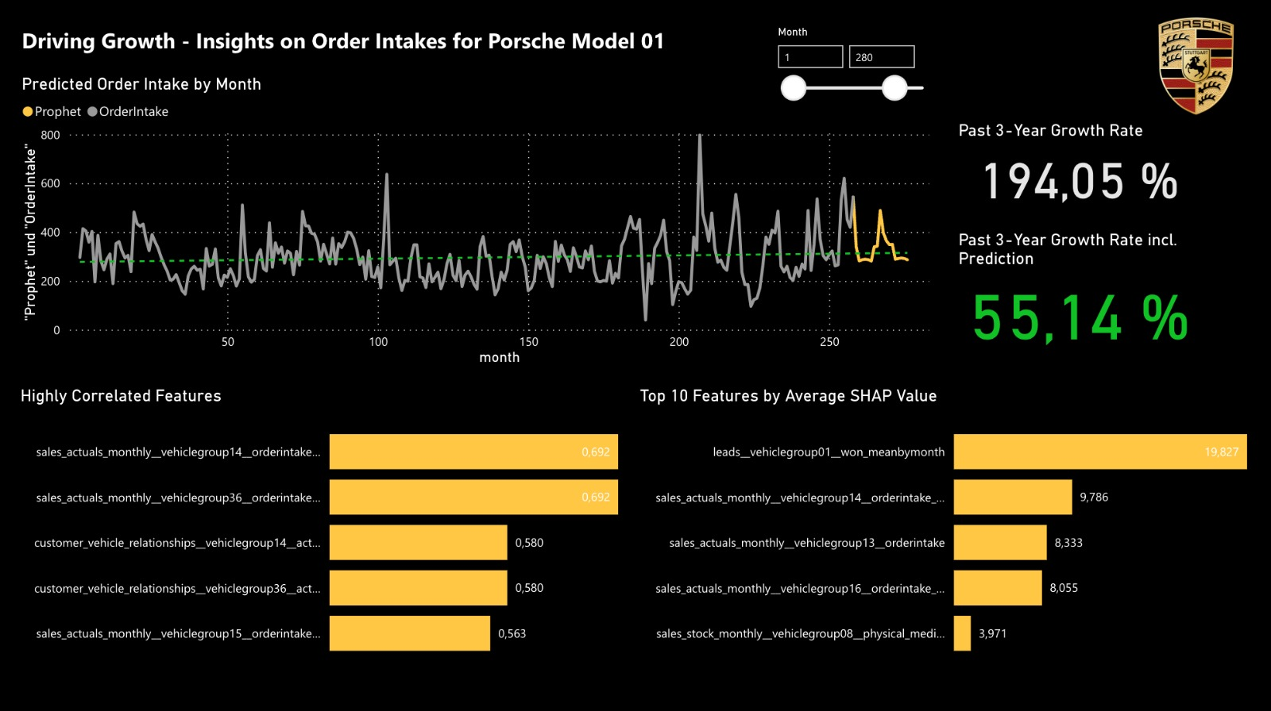

Driving Growth

Slide 5



Five Methods to Sufficiently Preprocess the Data
mean
by month
Feature exploration
List with important features
median
by month
original data with NaN values
interpolation
linear
filled data
interpolation
spline
model ready
data
fill
zero

Slide 6
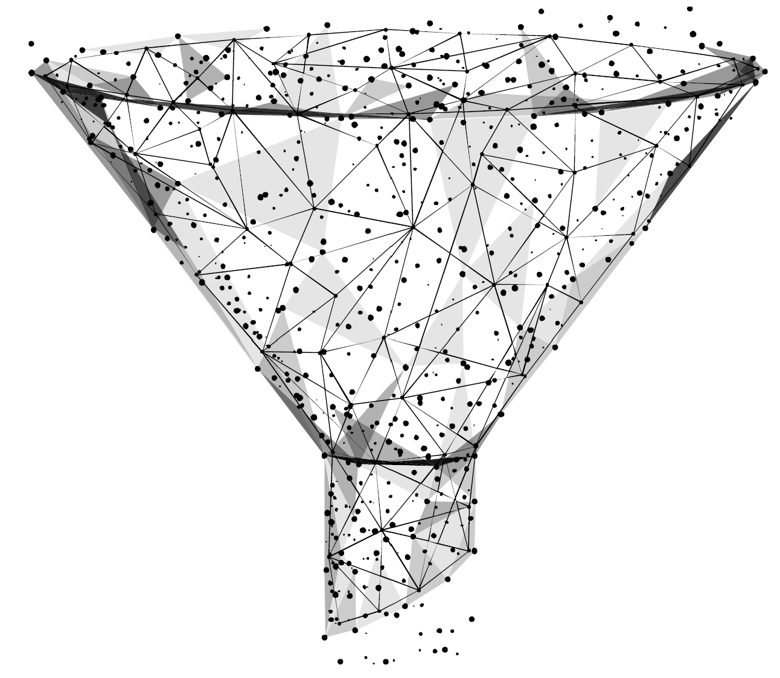


Core Idea: Building a Meta-Model with Three Sub-Models
Sub-Models
Choice of algorithms is typical for modelling the time series data
All algorithms have own (dis)advantages which influence predictions
SARIMA
RANDOM FOREST
Why Meta-Model?
Possibility to get best out of each algorithm & provide better prediction
Quick adaption for better short term modelling

Slide 7
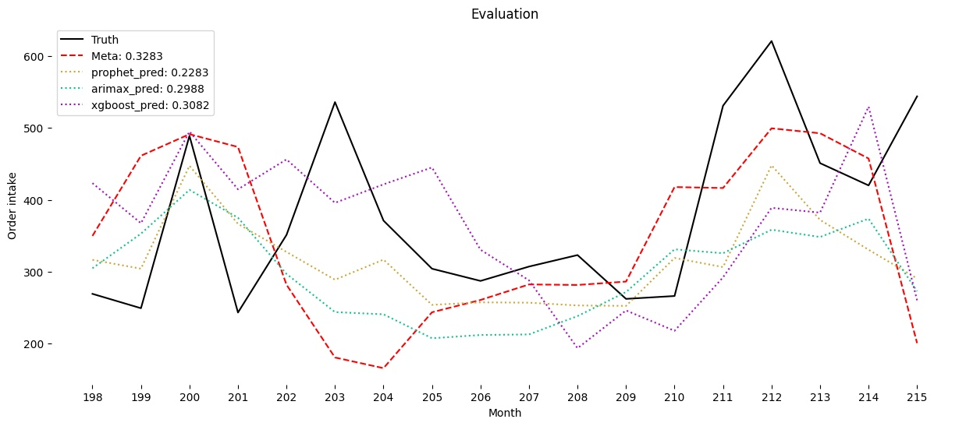

Prophet-Model Provides Best Results When Only Considering MAPE

Slide 8
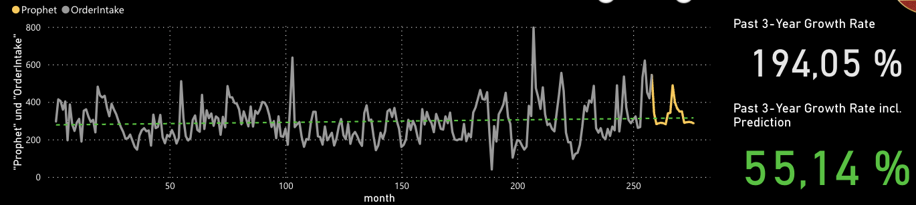
Data to Action

Slide 9




Data to Action
Maintain 3 shift operation
Ensure production capacity & utilization
Prepare for short-term decreasing & long-term increasing demand
Enough skilled workers?
(Re)new work contracts
Enough budget available for an increase in order input?
Adapt financial planning
New product launch or model adjustments
Could features be transferred to other vehicle groups?

Slide 10


Data to Action
#
Maintain 3 shift operation
Production capacity and production utilization
Increase of production possible?
Hold qualified personnel & Maintaining the employee growth of recent years
Invest in production automation
Enough budget available for an increase in order input?
Adapt financial planning
New product launch or model adjustments
Could features be transferred to other vehicle groups?

Slide 11
Data to Action
Maintain 3 shift operation
Production capacity and production utilization
Increase of production possible?
Enough skilled workers?
(Re)new work contracts
Invest in R&D of model to maintain stronger upward trend
New product launch or model adjustments
Could features be transferred to other vehicle groups?

Slide 12

Data to Action
Maintain 3 shift operation
Production capacity and production utilization
Increase of production possible?
Enough skilled workers?
(Re)new work contracts
Enough budget available for an increase in order input?
Adapt financial planning
Model-specific marketing to maintain the trend
Transfer product features from more strongly growing models to our model

Slide 13
We arrived safely at the end! We wish you a good ride home (after the next 2 groups)!

Slide 14
Approach
Strengths
Weaknesses
High predictive accuracy
Handles missing data
Longer training time
Time-consuming parameter tuning
Automatic seasonality detection
Intuitive parameter tuning
No handling of complex features
Long-term data sets needed
Long-term forecasting possible
Handles (non-) seasonal components
Manual engineering for complex features may be required
Need consistent time series
SARIMA

Slide 15
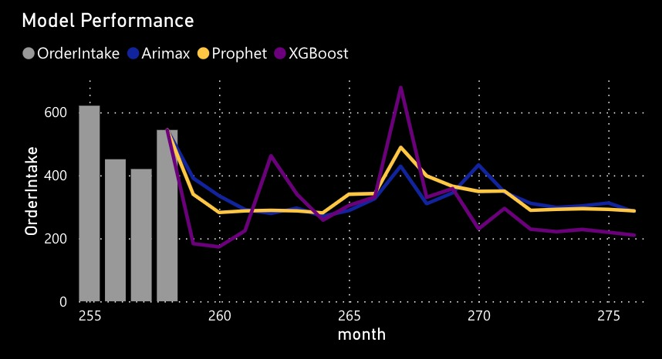
Different Model Predictions Differ Mainly in Volatility

